Slide 1

OFAC Resources and Contact Information

Slide 2
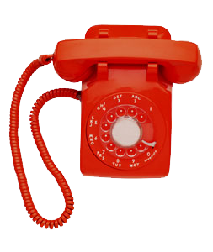
Contact Information
OFAC Compliance Hotline:
Toll Free: 1-800-540-6322
Phone: 202-622-2490
Email: OFAC_Feedback@treasury.gov
OFAC Licensing:
1-202-622-2480
www.treasury.gov/ofac
U.S. Department of the Treasury
Office of Foreign Assets Control
Freedman’s Bank Building
1500 Pennsylvania Avenue, NW
Washington, DC 20220

Slide 3
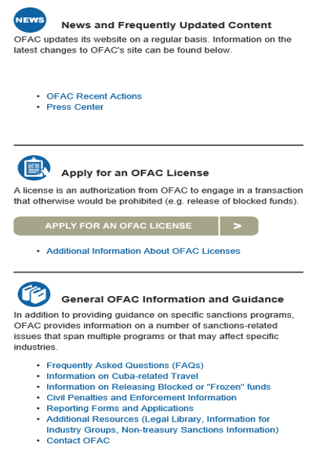
Sanctions Resources
See Recent Actions
Apply for a Specific License
Read FAQs & Guidance

Slide 4
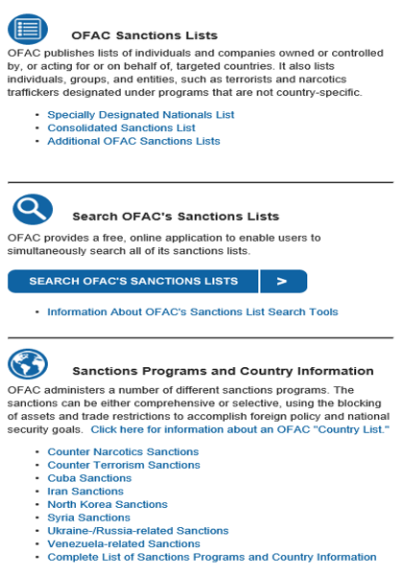
Sanctions Resources
Search the SDN List
Learn about the programs

Slide 5
OFAC Resources
Sanctions List Search
OFAC Recent Actions
OFAC's Frequently Asked Questions (FAQs)
Civil Penalties and Enforcement Information
Sanctions Programs and Country Information
eCFR
A Framework for OFAC Compliance Commitments
False Hit Lists Guidance
Sanctions Compliance Guidance for the Virtual Currency Industry
Guidance Related to the Provision of Humanitarian Assistance by Not-For-Profit Non-Governmental Organizations

